Slide 1

REAL-TIME MULTILINGUAL EMOTION DETECTION AND PRIVACY-PRESERVING DISTRIBUTED CHAT SYSTEM USING COSINE TRANSFORMER ATTENTION MECHANISM Presented By: Guided By. Sankalp Gupta Er. Shesh Mani Tiwari Suryansh Sharma Department Of Pranshu Yadav Computer Science , CSJM University , Kanpur

Slide 2
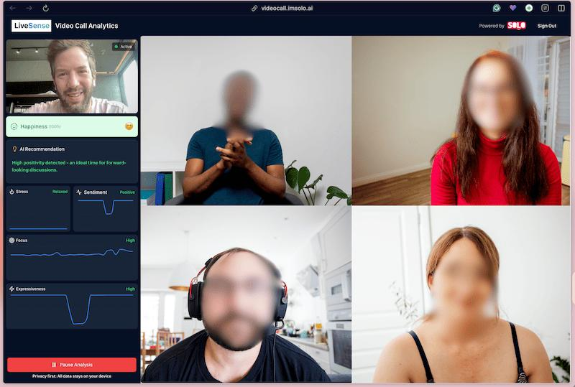
INTRODUCTION Problem 1. Traditional chat systems cannot understand emotions 2. No emotional intelligence in communication 3. Text + facial emotions handled separately
Proposed Solution
1. Real-time multilingual emotion detection 2.Facial emotion recognition using webcam 3. Distributed synchronized communication AI-driven live emotional analytics
Core Technologies Frontend(Streamlit) ⇄ Fast API Rest APIs⇄ Backend AI Processing
Key Flow • Emotion Detection • API Communication
• Multi-User Synchronization • Real-Time Processing
• Live Analytics Display • Shared Camera Control

Slide 3
PROBLEM STATEMENT Existing communication systems only support messaging and video interaction but cannot understand human emotions during communication. They also lack sarcasm detection, multilingual understanding, and synchronized real-time emotional monitoring. • Cannot understand user emotions • Cannot detect sarcasm • No live emotion tracking • Camera conflicts between users • Limited language support • Weak user synchronization

Slide 4
Objective The main objective of the project is to create an intelligent distributed communication platform capable of understanding human emotions dynamically during live interaction • Detect Emotion in Multilingual text Messages • Identify sarcasm from conversational text • Perform real-time facial emotion recognition • Synchronize emotional analytics between connected users • Implement privacy Preserving webcam sharing • Generate live emotion monitoring dashboard Expected Output : The system continuously analyzes user messages and facial expressions, predicts emotions using AI models, and displays synchronized emotional analytics across connected users in real time.

Slide 5
Frontend → Backend → AI Models → Analytics
Technologies Used
Technology | Purpose
Streamlit | Frontend UI & dashboard
Fast API | Backend API Communication
Transformers | Text Emotion Detection
CNN | Facial Emotion Recognition
Open CV | Webcam processing
Tensorflow | Deep learning Execution
JSON sync | Multi client Synchronization

Slide 6
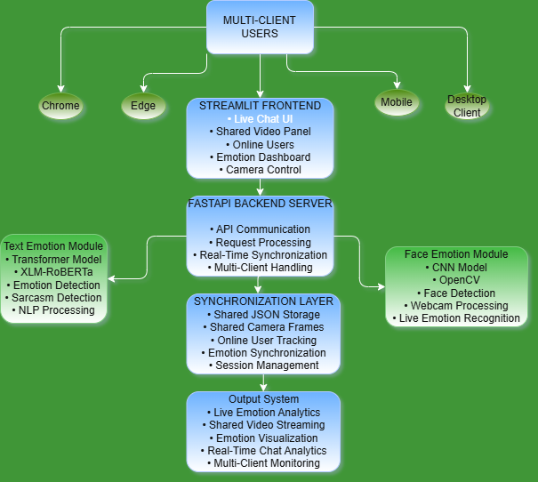
System Architecture
System Modules
• Multi client user layer
• Streamlit frontend
•Fast api backend
• NLP emotion module • CNN face emotion module • Synchronization layer
Internal Working
1.User sends message/webcam input
2. Frontend transfers request
3.Backend processes emotion prediction 4. Results synchronized to all users 5.Dashboard displays analytics

Slide 7
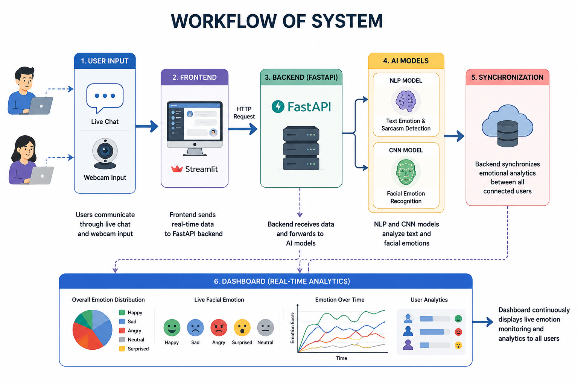
Work Flow of The System
• Users communicate through live chat and webcam input
• Frontend sends real-time data to the FastAPI backend
• NLP and CNN models analyze text and facial emotions
• Backend synchronizes emotional analytics between users
• Dashboard continuously displays live emotion monitoring

Slide 8
Text Emotion Detection Module
Internal Working
‘1. User message sent to backend
2. Transformer converts text into vectors
3.Cosine similarity compares semantic meaning
4. Emotion prediction generated in real time
Cosine Attention
Traditional Transformer: Dot Product Attention
Proposed System: Cosine Similarity Attention
Formula Cosine(Q,K) = (Q·K)/ (||Q||×||K||)
Why Cosine?
1. Better multilingual matching
2. Similar meaning → similar vectors
3. Handles Hindi + English semantic relation
4. Improves sarcasm understanding
Example “I am happy” ≈ “Main khush hu”
Output Emotions : Joy | Anger | Sadness | Fear | Neutral

Slide 9
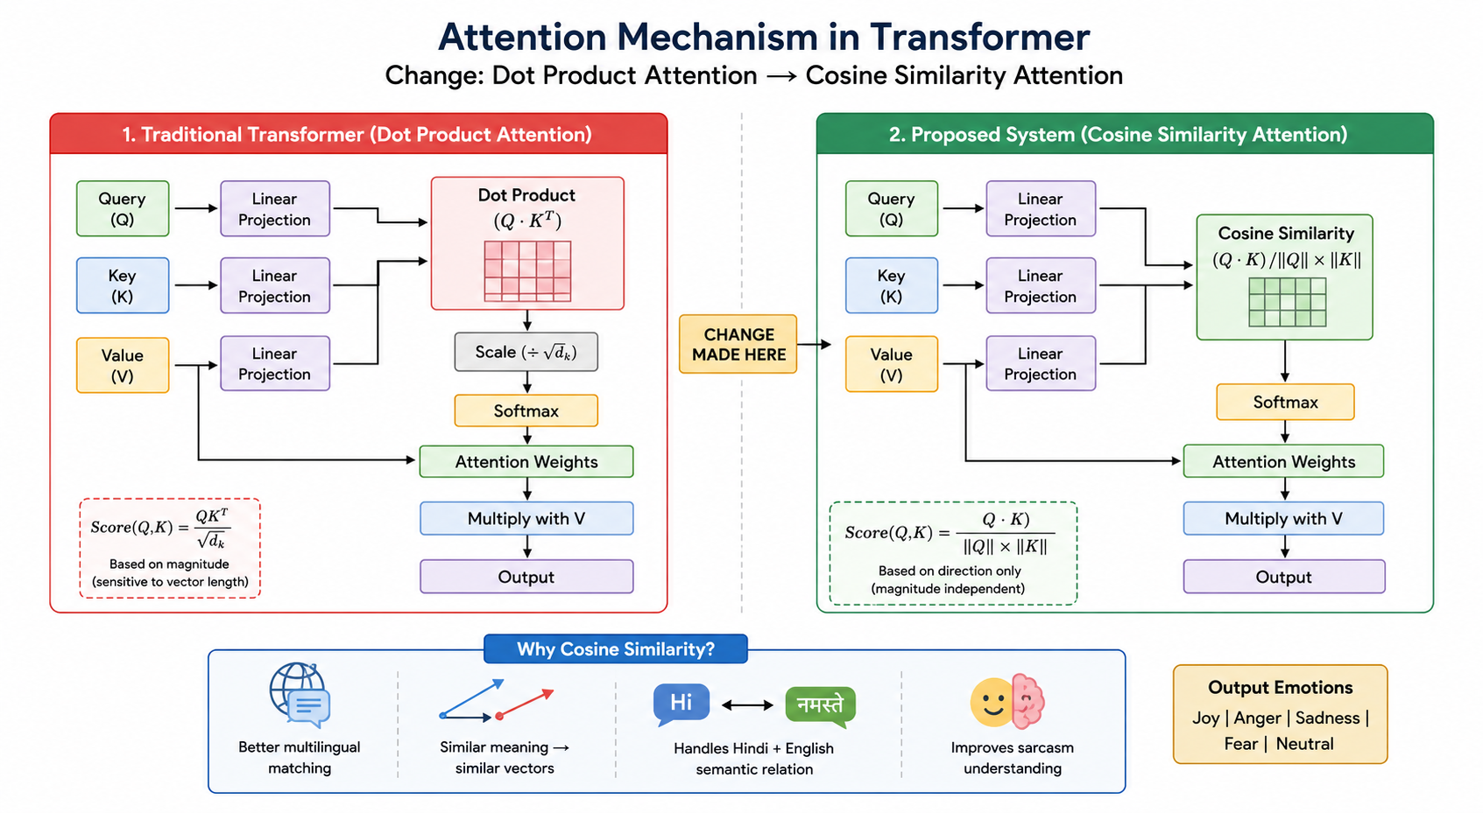
Text Emotion Detection Module from Changed Mechanism

Slide 10
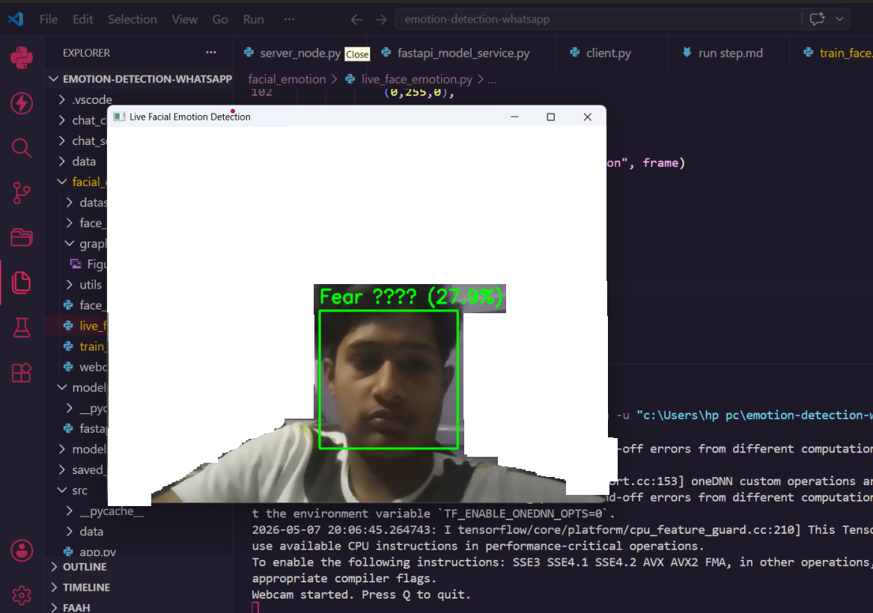
Facial Detection Emotion Module
Internal Working
Webcam captures live frame
OpenCV performs face detection
CNN analyzes facial expression
Emotion predicted in real time
Technologies Used
OpenCV
CNN
TensorFlow
Keras
Facial Emotions Happy | Sad | Angry | Fear | Neutral | Surprise Processing Flow Webcam → Face Detection → CNN → Emotion Prediction

Slide 11
Shared Camera Synchronization

Slide 12
Model Training And Result

Slide 13
Applications

Slide 14
Future Enhancement

Slide 15
Conclusion

Slide 16
thank you

